Slide 1
WEB PROGRAMMING TRANING
BY
A.D. Adekale, Ja’afar Sadiq, Muhammed B. Ibrahim, Erasmus O. Edward

Slide 2
DAY 5. LINKS AND FORM

Slide 3
Introduction
A link in HTML is a hypertext reference that allows users to navigate to another web page or resource.
Links are often used to connect related pages on a website, or to provide additional information about a topic.
In this presentation, we will learn how to use links in HTML to create effective and informative web pages.

Slide 4

The <a> link Tag
The <a> tag is used to define a link in HTML.
The <a> tag has two required attributes:
The href attribute, which specifies the URL of the linked page.
The target attribute, which specifies where the linked page will open.
The <a> tag can also have a number of optional attributes, such as the title attribute, which provides a description of the link

Slide 5
Examples of Links
Here is an example of an HTML link that points to the Google homepage:
HTML
<a href="https://www.google.com">Google</a>
Link that opens the link in a new tab
<a href=https://www.google.com target=“_blank> Google.com</a>
<a href=“#about”>About</a>

Slide 6
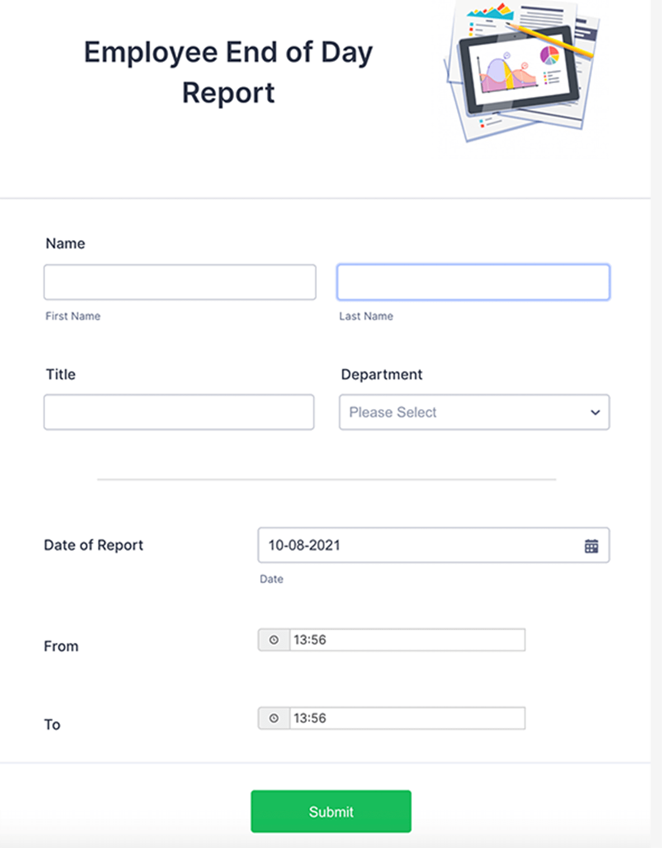
: Introduction
A form in HTML is a way to collect user input.
Forms are often used to collect information such as names, addresses, email addresses, and passwords.
In this presentation, we will learn how to use forms in HTML to create effective and informative web pages.

Slide 7
The <form> tag is used to define a form in HTML.
The <form> tag has a number of attributes that can be used to control the behavior of the form, such as the action attribute, which specifies the URL where the form data will be sent, and the method attribute, which specifies the method used to send the form data (GET or POST).

Slide 8
: Form Elements
There are a number of different form elements that can be used to collect user input, such as:
Input fields: Input fields are used to collect text input from users.
Textareas: Textareas are used to collect large amounts of text input from users.
Radio buttons: Radio buttons are used to collect single selections from users.
Checkboxes: Checkboxes are used to collect multiple selections from users.
Select lists: Select lists are used to collect a single selection from a list of options.
Submit buttons: Submit buttons are used to submit the form data to the server.

Slide 9
Here is an example of an HTML form that collects a user's name, email address, and password:
HTML
<form action="https://www.example.com/process_form.php" method="post">
<input type="text" name="name" placeholder="Your name">
<input type="email" name="email" placeholder="Your email address">
<input type="password" name="password" placeholder="Your password">
<input type="submit" value="Submit"></form.

Slide 10
Here is an example of an HTML form that collects a user's favorite colors:
HTML
<form action="https://www.example.com/process_form.php" method="post">
<input type="radio" name="color" value="red"> Red <input type="radio" name="color" value="blue"> Blue <input type="radio" name="color" value="green"> Green <input type="submit" value="Submit"></form>

Slide 11
: Conclusion
Links are very important in a web page they are use to link a page with another page or another web site
Forms are a powerful tool that can be used to collect user input.
By understanding how to use forms, you can create web pages that allow users to interact with your content and provide you with the information you need.

Slide 12
THANK YOU.

